Slide 1






Lecture 6:
Event Types
Course - Web Development - II
-By
Instructor Name
welcome@krmangalam.edu.in
Sohna Road,Gurugram,Haryana 122103

Slide 2

| Table of Contents
click & mouseover
keydown & keyup.
submit events
References.
The End.

Slide 3

|
Yesterday we learned how to listen for a 'click'. But users do much more — they type, scroll, move the mouse, submit forms, and more. Let's dive into the wide world of DOM events.

Slide 4
| Types of Events
JavaScript events can be categorized into several groups.
Some Common Categories :
Mouse Events.
Keyboard Events.
Form Events.

Slide 5
| Mouse Events
Mouse events are a type of browser event that occur when the user interacts with the mouse — clicking, hovering, moving, or pressing mouse buttons on elements in a webpage.
These events allow JavaScript to respond to user actions and make the web page interactive.
Common Mouse Events :
click.
mouseover.

Slide 6
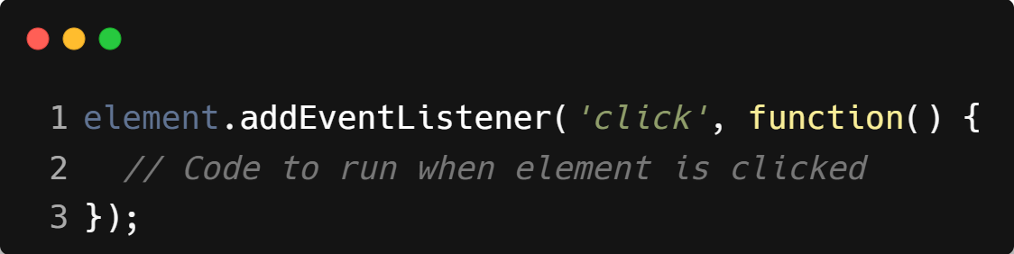
| click Event
The click event fires when the user presses and releases the left mouse button on an element.
Commonly used to trigger actions like form submission, opening modals, toggling UI.
Syntax :

Slide 7
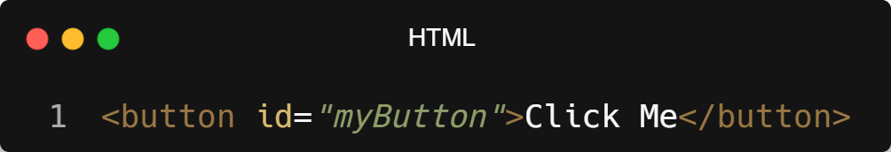
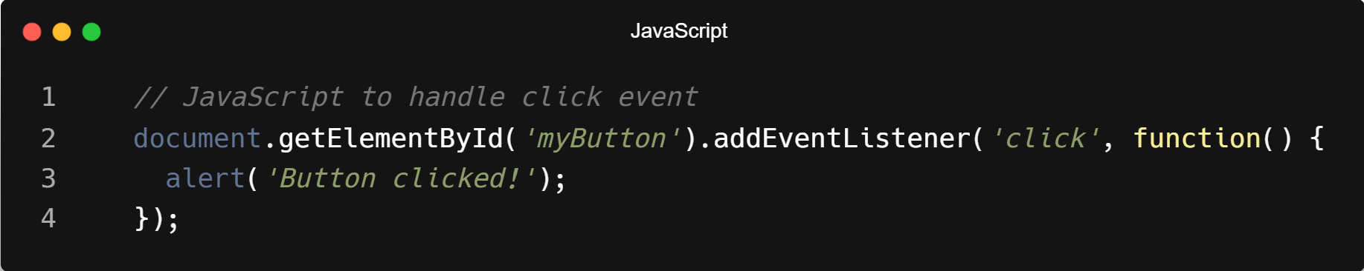
| Example : click Event

Slide 8
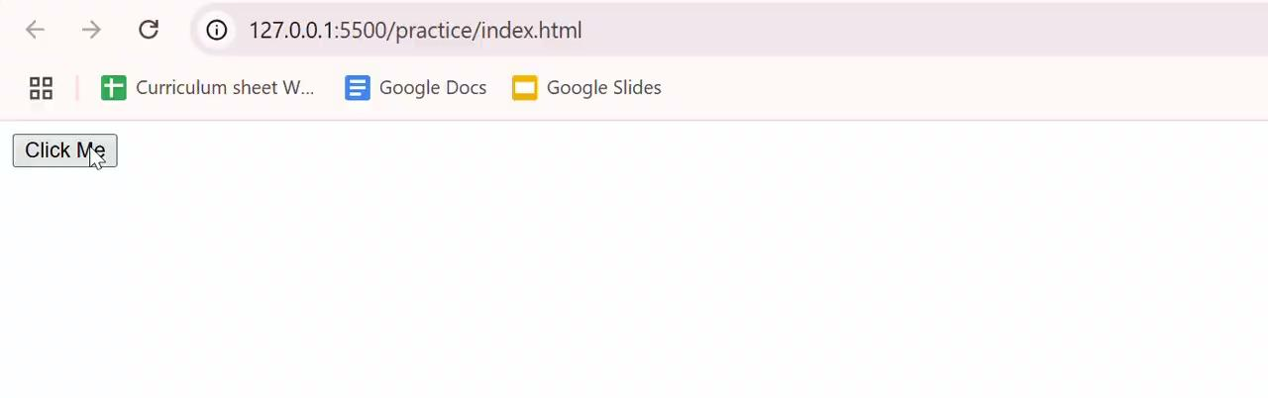
| Output : click Event

Slide 9
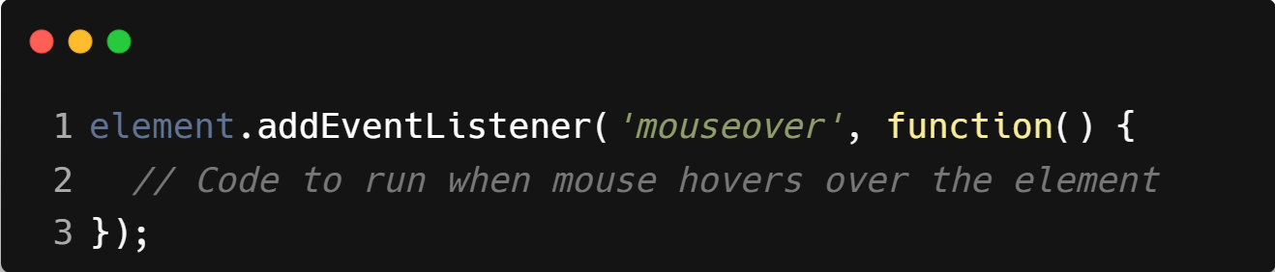
| mouseover Event
The mouseover event fires when the mouse enters the area of an element.
Every time the pointer enters the element or any child element of it.
Syntax :

Slide 10
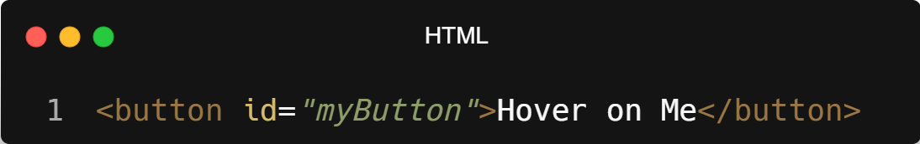
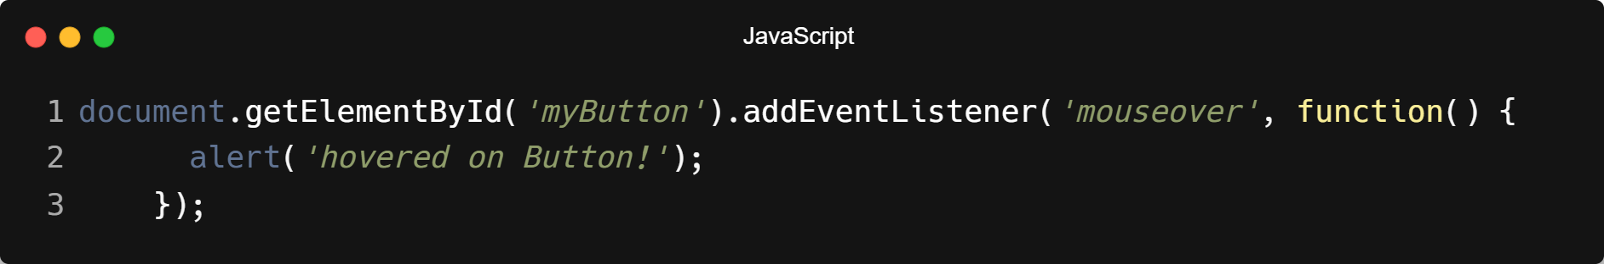
| Example : mouseover Event

Slide 11
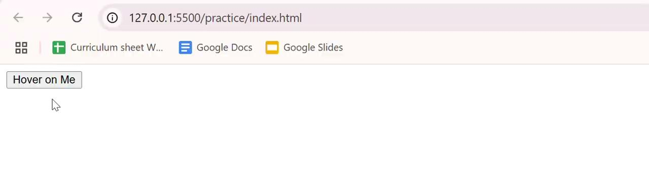
| Output : mouseover Event

Slide 12

| Coding Questions
1. mouseover and mouseout Events
Task :
Given the HTML below, write a script to select the div with the ID hover-box. Add an event listener so that when the mouse moves over it, its background color changes to lightblue. Add another event listener so that when the mouse moves out, the background color reverts to white.

Slide 13
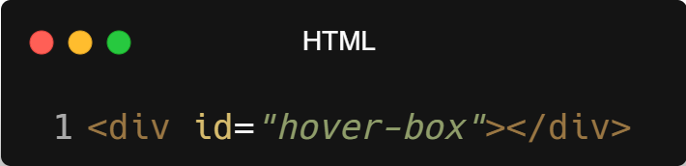
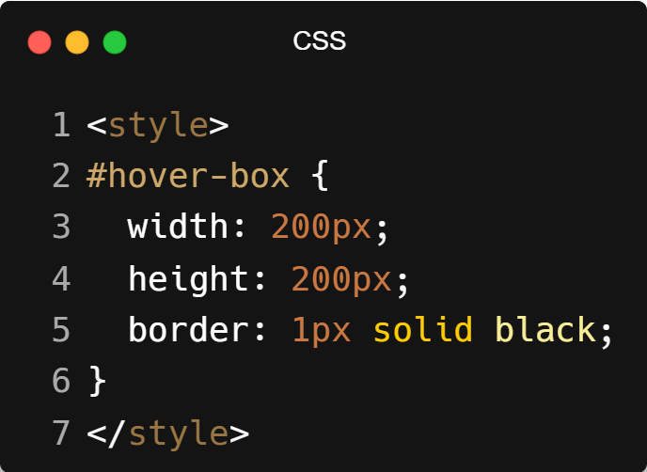
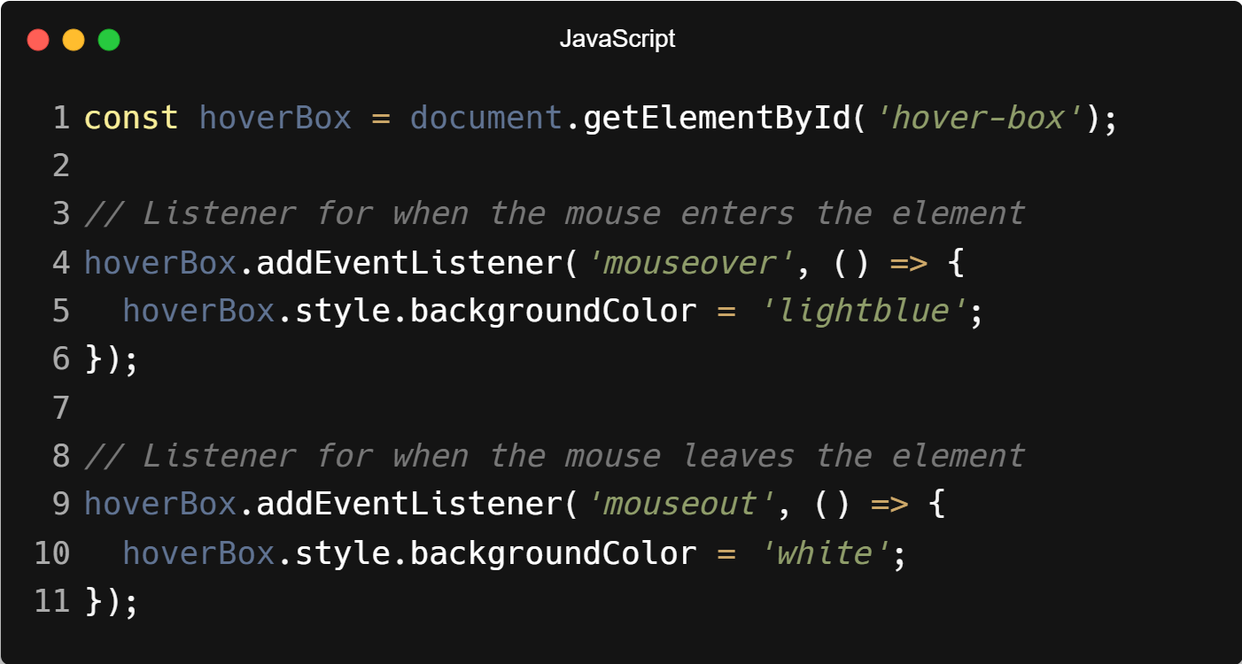
| Coding Questions
Solution :

Slide 14

| Coding Questions
Output :

Slide 15
| Keyboard Events
A keyboard event in JavaScript is triggered when the user presses, holds, or releases a key on the keyboard.
It allows your webpage to respond to key actions, like shortcuts, search input, form navigation, games, etc.
Common Keyboard Events :
keydown.
keyup.

Slide 16
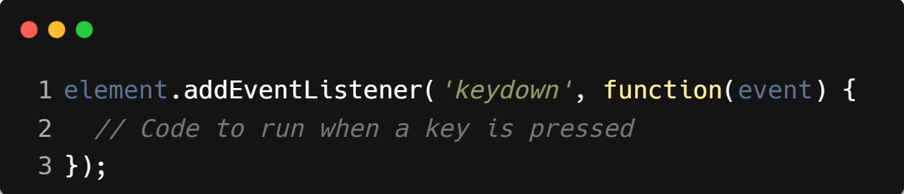
| keydown Event
The keydown event is triggered when a key is pressed down on the keyboard.
It fires once, immediately when the key is pressed (even if it's held down).
Syntax :

Slide 17
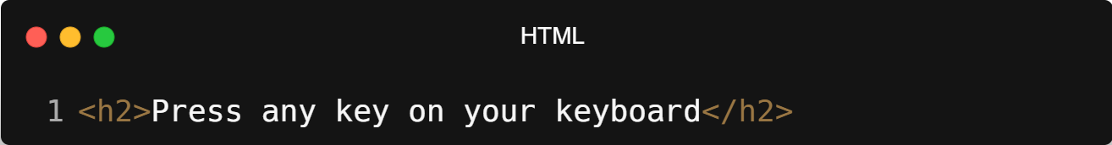
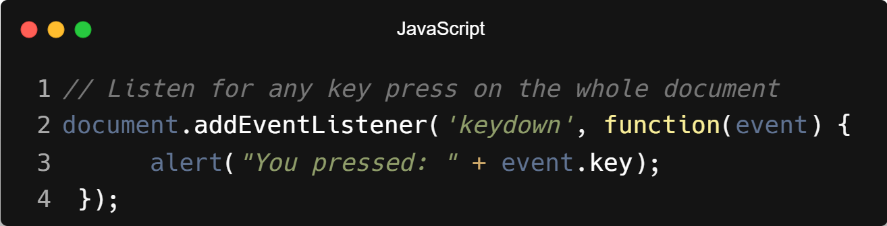
| Example : keydown Event

Slide 18
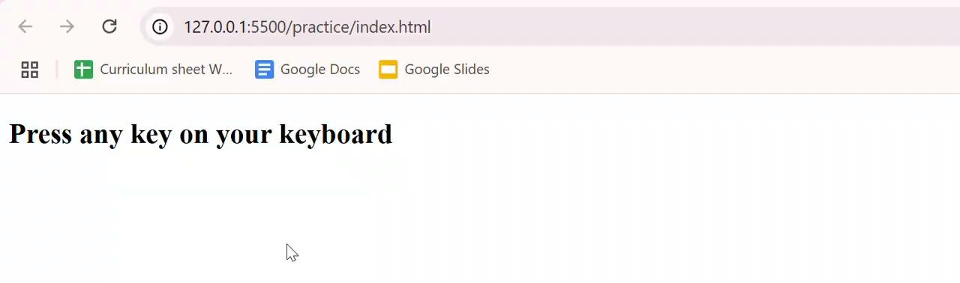
| Output : keydown Event

Slide 19
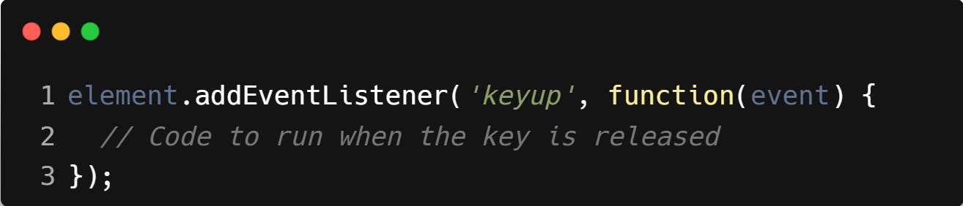
| keyup Event
The keyup event is triggered when a key is released after being pressed.
It’s useful when you want to perform an action after the keypress is complete.
Syntax :

Slide 20
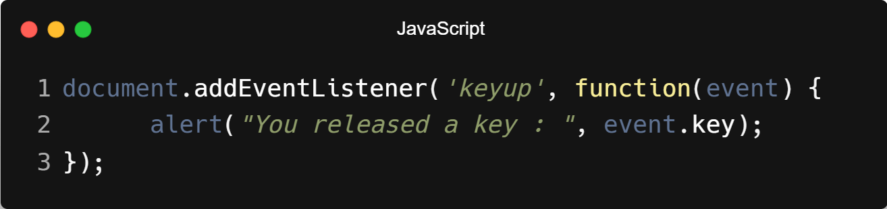
| Example : keyup Event

Slide 21
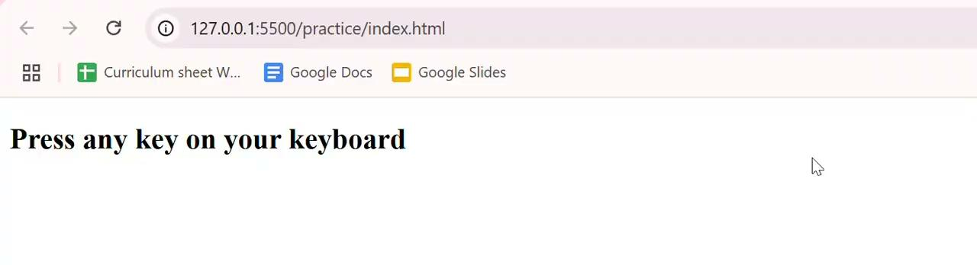
| Output : keyup Event

Slide 22
| Coding Questions
1. keydown Event
Task :
Given the HTML below, add a keydown event listener to the input field. When the user presses any key while the input is focused, log the key property from the event object to the console.

Slide 23
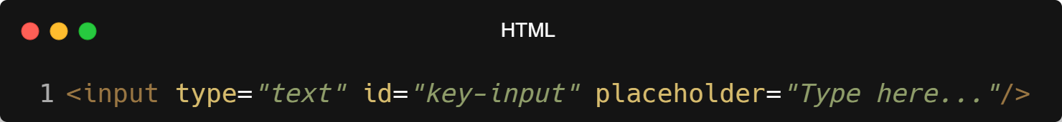
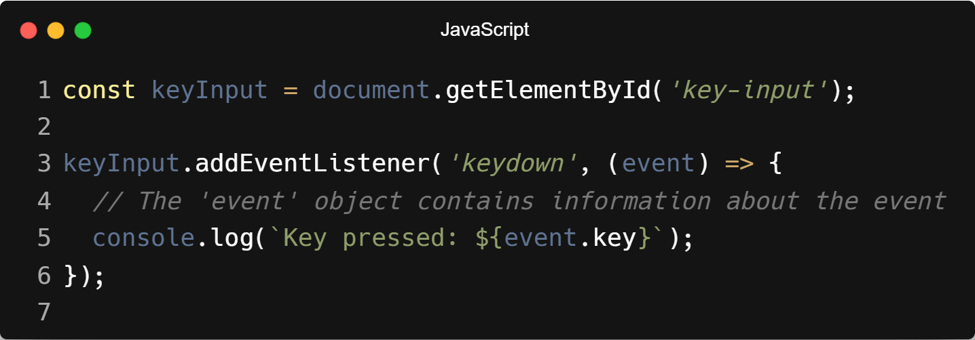
| Coding Questions
Solution :

Slide 24
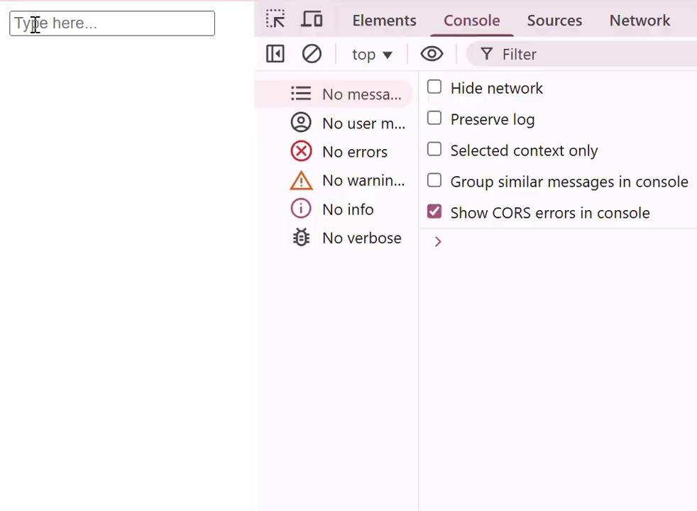
| Coding Questions
Output :

Slide 25
| Forms Events
Form events are triggered by user interactions with HTML form elements like <input>, <textarea>, <select>, and <form> itself.
JavaScript can listen to these events to validate, modify, or control form behavior in real time.
Common Form Event :
submit.

Slide 26
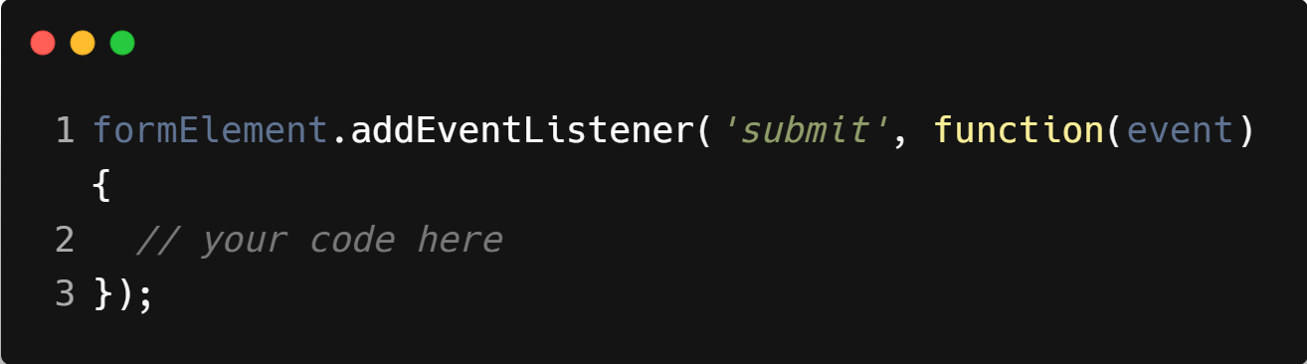
| submit Event
The submit event occurs when a form is submitted — usually when the user clicks a submit button or presses Enter inside a form field.
It allows you to handle or prevent form submission using JavaScript, such as validating input before sending.
Syntax :

Slide 27
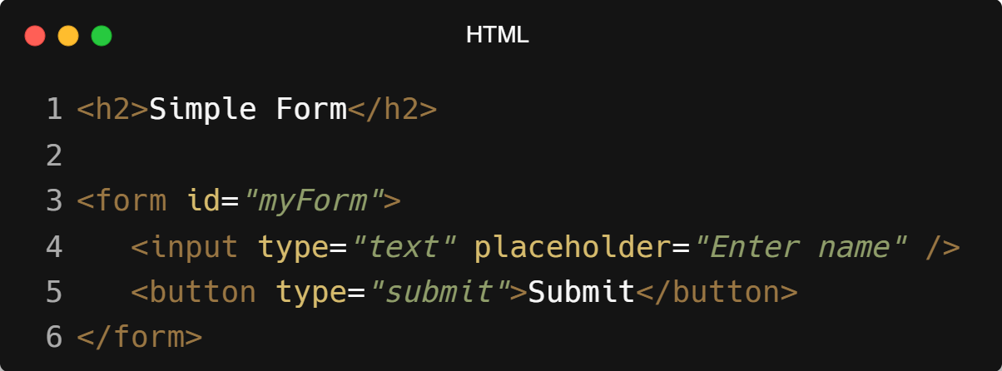
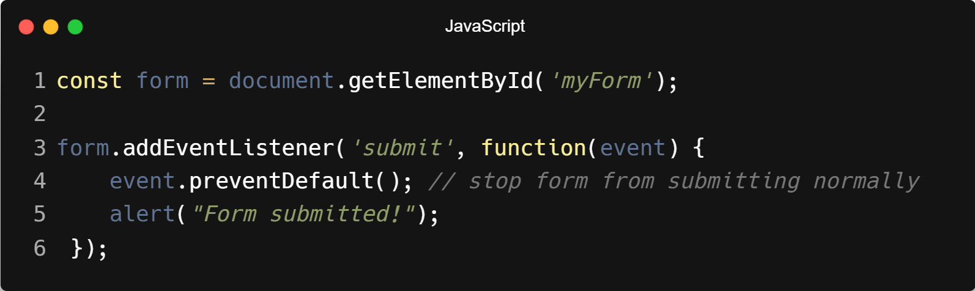
| Example : submit Event

Slide 28
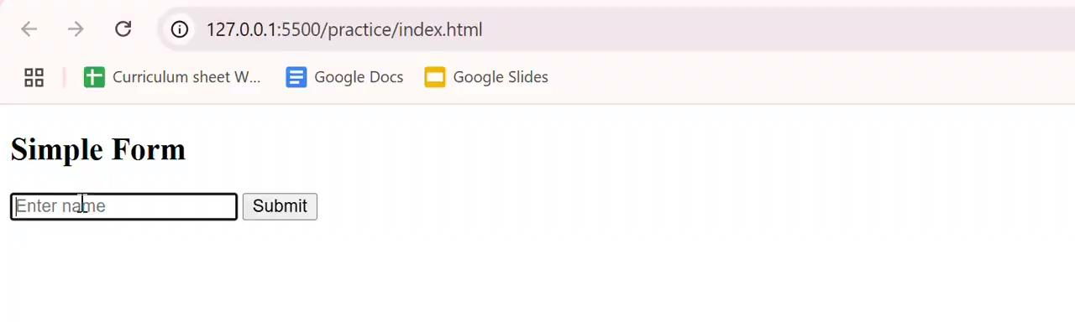
| Output : submit Event

Slide 29
| Check Your Understanding
Question : Which event is fired when a user presses down on a key on the keyboard?
Options : a) keyup
b) keypress
c) keydown
d) click
Answer : c) keydown
Explanation:
The keydown event is triggered the moment a key is pressed down. keyup is fired when the key is released.

Slide 30
| Check Your Understanding
Question : Which event is triggered when the mouse pointer moves onto an element?
Options : a) click
b) mouseout
c) mouseover
d) mousemove
Answer : c) mouseover
Explanation:
mouseover fires once when the mouse enters the element's boundary. mousemove fires continuously as the mouse moves over the element.

Slide 31
| Check Your Understanding
Question : The submit event is typically used with which HTML element?
Options : a) <button>
b) <input>
c) <div>
d) <form>
Answer : d) <form>
Explanation:
The submit event is fired on the <form> element itself when the user attempts to submit it, either by clicking a submit button or pressing Enter.

Slide 32
| References
MDN Web Docs : Comprehensive and official documentation for JS.
🔗https://developer.mozilla.org/en-US/docs/Web/JavaScript
W3Schools – JS Tutorial : Beginner-friendly JS tutorials with examples and interactive editors.
🔗 https://www.w3schools.com/js/
JavaScript.info - A comprehensive tutorial-style website that covers core JavaScript concepts in depth.
🔗https://javascript.info/

Slide 33
Thanks
For
Watching
Course - Web Development - II
welcome@krmangalam.edu.in
Sohna Road,Gurugram,Haryana 122103

